Slide 1

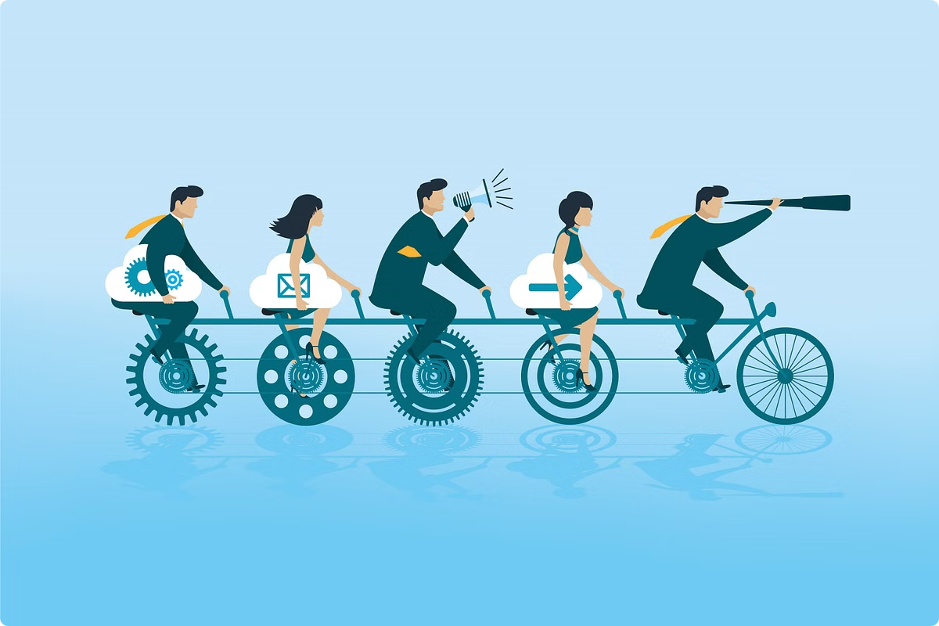
PJM 6910 Capstone Project
Weeks 3-4: Drafting Project Scope, Defining Requirements, and Sponsor Meeting
Team 5: Akrati, Deepthi Sri, Sharanya, Sneha, Soumyadeep, Vismita

Slide 2
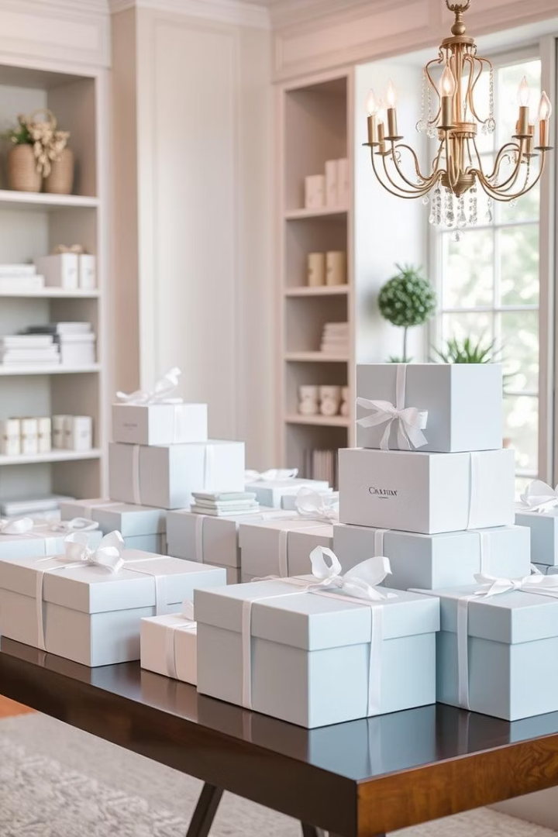
Enhancing Digital Identity for The Knots Studio
The Knots Studio, a boutique gifting venture founded in 2022 in Bangalore, India, specialises in thoughtful, customizable bulk gifting solutions for corporate clients and special occasions. Despite the founder’s extensive corporate experience, the brand currently lacks a cohesive digital presence, limiting visibility and growth potential.
This project aims to design and deliver a fully functional website that reflects the brand’s heart-driven gifting philosophy, enhancing client engagement and lead generation.

Slide 3
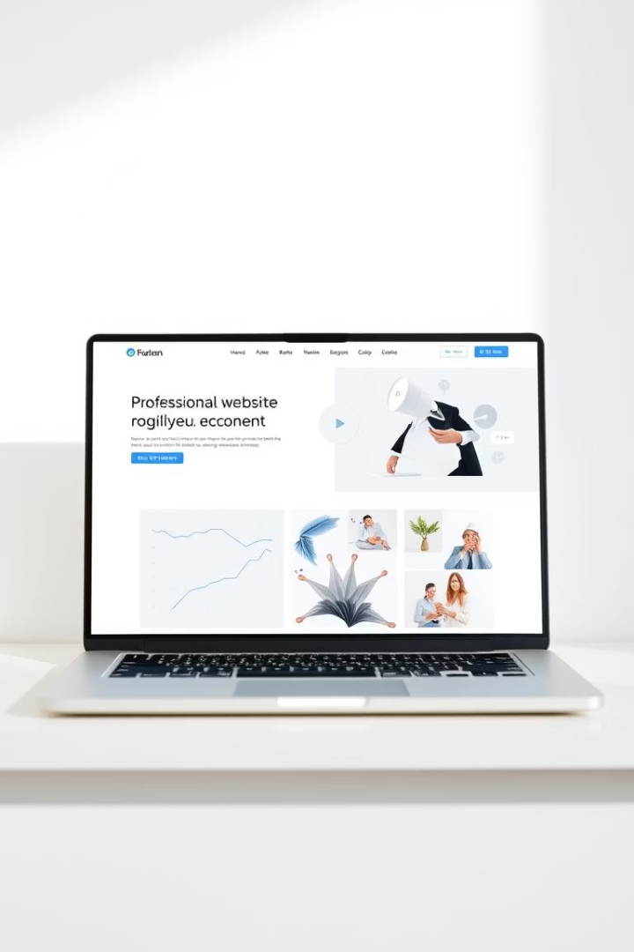
Project Scope and Objectives
Scope
Objective
End-to-end design and implementation of a user-friendly, visually consistent website to amplify The Knots Studio’s reach and streamline client communication.
Create a professional platform that communicates the brand’s offerings, values, and story, serving as a lead generation and client interaction tool.
Out-of-Scope
Excludes full branding overhaul, payment integration, e-commerce features, and social media management.

Slide 4
In-Scope Deliverables
Planning & Strategy
Design & Development
Platform Setup & Handoff
Requirements gathering with sponsor
Mobile-responsive, clean design
Build on Wix or WordPress CMS
Homepage with brand narrative
Documentation for content updates
User personas and journey mapping
Service pages, testimonials, gallery
Optional design assets if needed

Slide 5






Functional Requirements
Homepage
Engaging design with brand mission, hero imagery, CTAs, and navigation linking to all sections.
Service Pages
Dedicated pages for corporate gifting, weddings, seasonal offers with descriptions, images, and inquiry buttons.
Gallery & Testimonials
Visual portfolio arranged by event type and client testimonials to build trust.
Contact & Navigation
Easy contact form, embedded Google Maps, consistent header and footer with quick links and social icons.
By Deepthi Sri

Slide 6
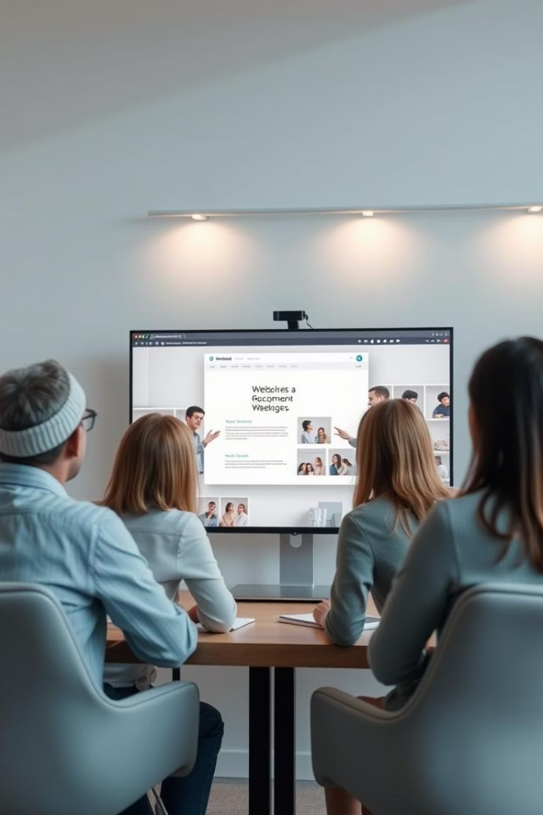
Project Management and Communication
1
Initial Requirements Gathering
Week 3 and 4, Zoom meeting to discuss goals, scope, and creative direction.
2
Midpoint Design Review
Week 7 and 8, Zoom session to review homepage and service page layouts.
3
Final Prototype Review
Week 9 and 10, Zoom meeting for design sign-off and feature approval.
4
Handover & CMS Training
Week 10 and 11, Zoom/Google Meet for website transfer and sponsor training.

Slide 7

Success Criteria and Impact
Success Criteria
Impact
On-time delivery, functional and brand-aligned website, sponsor satisfaction, live and accessible platform.
Establishes The Knots Studio as a credible gifting brand online, expands reach, supports lead capture, and enhances storytelling.
Value
Sets foundation for future marketing and digital scaling, empowering the sponsor to maintain and update the site independently.

Slide 8
Sponsor and Contact Details
Sponsor
Location
Ms. Aarthy Balachandran, Founder & Creative Director, The Knots Studio
No.343, Daiwik Gokul, 14th cross, 2nd block, Jayanagar, Bangalore 560011
Email: Theknotsstudio@gmail.com
Phone: +9980230859

Slide 9
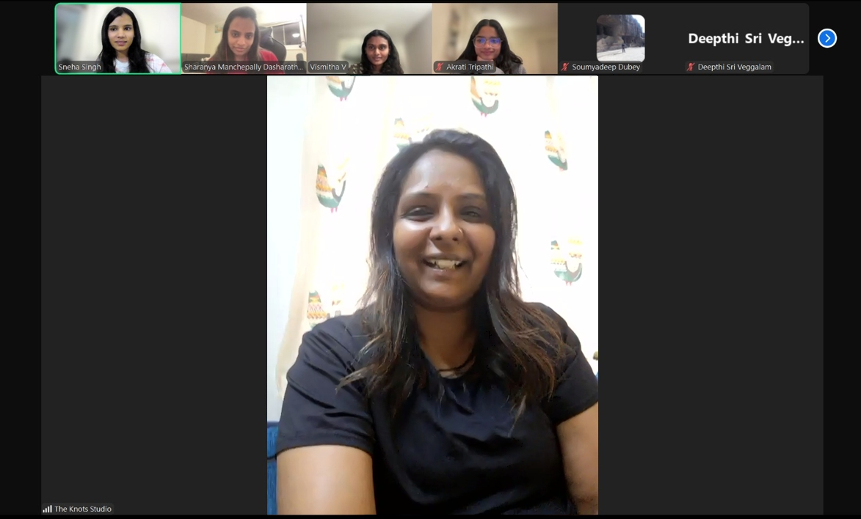
Evidence of the Meeting with the Sponsor
Team meeting with Ms. Aarthy Balachandran, Founder & Creative Director, The Knots Studio

